Slide 1
Job-Driven Technical Assistance Center (JD-VRTAC):
Arkansas Rehabilitation Services
Equation for Success
“Collaboration + Creativity = Cohesion”
Rodney Chandler, Business Engagement Director
Ashley Cross, Corporate Accounts Manager
Yvonne Rowland, Business Engagement Administrator

Slide 2
Webinar Objectives
Explain JD-VRTAC goals, partners, TA, and Learning Collaborative
Describe Arkansas Rehabilitation Services background/services
Explain ARS JD-VRTAC project background
Discuss ARS JD-VRTAC project purpose & goals
Describe ARS JD-VRTAC project implementation
Share ARS JD-VRTAC project accomplishments
Share challenges & lessons learned from ARS JD-VRTAC project
Describe current status of ARS JD-VRTAC project
Discuss what was most helpful from the TA and Learning Collaborative throughout this process
Share next steps, future direction, & goals for Arkansas

Slide 3
JD-VRTAC Goals
To Improve the skills of state VR agency staff, other rehab professionals & providers of VR services (who are trained to provide “job-driven” VR services & supports to PWD), employers, and customized training providers.
Four Topic Areas:
Business Engagement
Employer Supports
Labor Market Information (LMI)
Customized Training Providers
www.explorevr.org

Slide 4
JD-VRTAC Partners
Institute for Community Inclusion (ICI), Univ. of Massachusetts/Boston
In Partnership with:
Jobs for the Future (JFF)
Univ. of Arkansas/CURRENTS
Univ. of Washington
Council of State Administrators of Vocational Rehabilitation (CSAVR)
United States Business Leadership Network (USBLN)
Association of University Centers on Disabilities (AUCD)
In Collaboration with:
National Council of State Agencies for the Blind (NCSAB)
Technical Assistance Center Collaborative

Slide 5
JD-VRTAC Learning Collaborative
As part of receiving intensive TA, states attended 2-3 in-person Learning Collaborative meetings to provide project updates, collaborate across agencies, and participate in topical discussions.
Learning Collaborative states participate in conference calls with their cohort to discuss job- driven topics.
18 state VR agencies are part of the JD-VRTAC
Learning Collaborative.

Slide 6
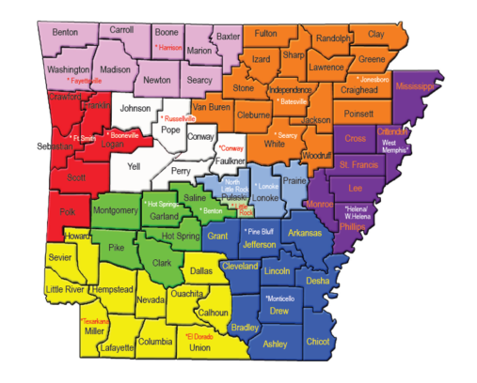
VR Background
10 Districts and 19 field offices across the state
12 Business Services Specialists
ACTI
60 VR Counselors
Access and Accommodations Team
District I
District II
District II
District IV
District V
District VI
District VII
District VIII
District IX
District X

Slide 7
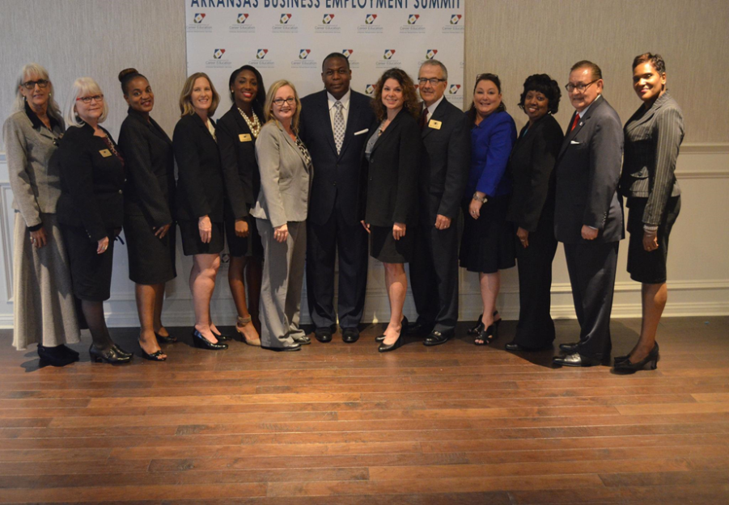
ARS BE Model Pre-TA
BER’s dual role of business engagement and business development.
BERs work directly with clients referred by VR counselors
Traditionally involved at end of client’s vocational rehabilitation
Skilled clients underemployed due to lack of skill set demand in their geographic area.
Business Relationships developed based on client need

Slide 8
Rethinking the Process
Jeanne Miller, UA Currents
Explore VR
Successful BE models
Team assembled
What are doing right?
How can we improve?
Core objectives identified by team

Slide 9
JD-VRTAC Project Purpose
The JD TA project is designed to strengthen and broaden business relations in Arkansas and integrate the use of data and labor market intelligence leading to the next level of customer engagement resulting in improved employment outcomes for people with disabilities.

Slide 10
JD-VRTAC Project Goals
Project Objectives:
Foster Increased Collaboration between Field Services and Business Engagement Staff
Develop strategies and data collection tools
Training at all levels to integrate business strategy for increasing outcomes
Understand and apply Labor Market Information
Evolving process
Increase Agency engagement with business leadership and partner service agencies
Business Customer Satisfaction Survey
Notes:
Project goals

Slide 11
JD-VRTAC Project Implementation
Business Engagement initiated communications meetings with ARS leadership in conjunction with support form JDVRTAC to introduce shift to business as a customer.
Senior leadership joined Business Engagement unit in customer visits throughout the agency.
Marketing materials were rewritten to speak from demand side.
VR counselors and BE team collaborated to discuss LMI and strategy to align around the client at the beginning of plan service.
The Business Summit seen as benefitting the agency as a whole rather than solely a departmental endeavor.
Business Engagement visits and presents to partner workforce agencies to enhance collaboration.

Slide 12
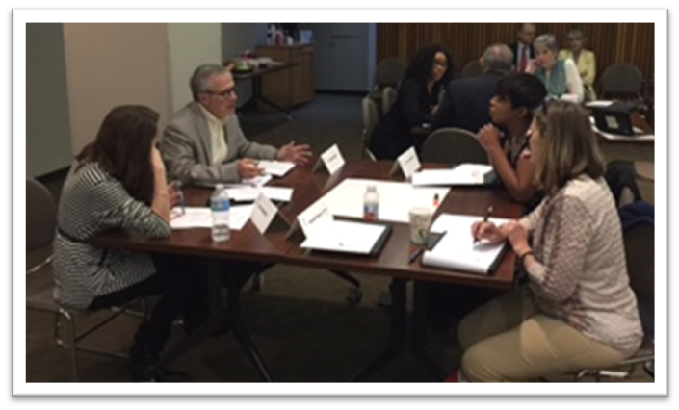
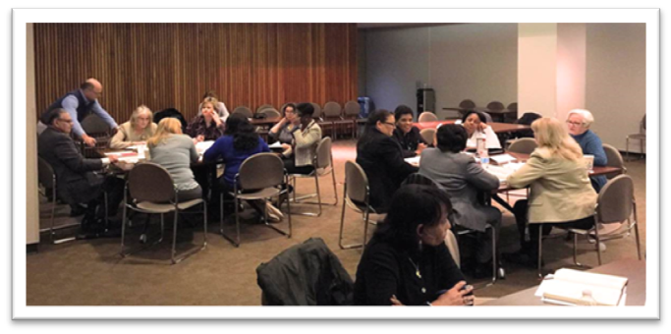
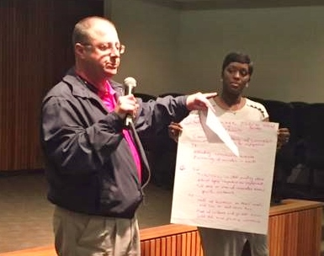
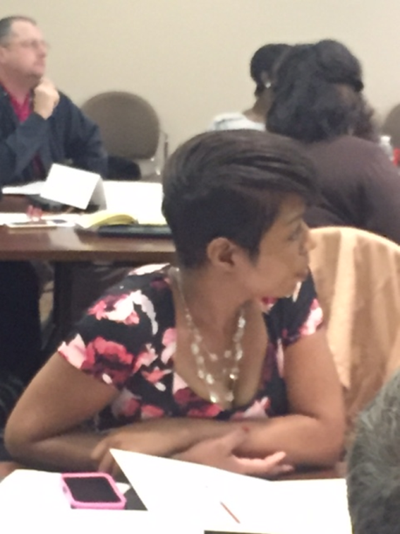
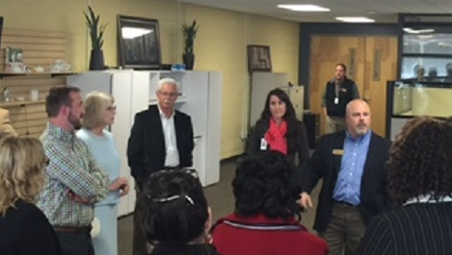
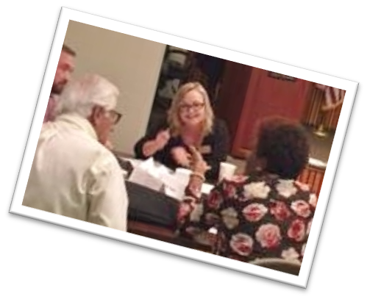
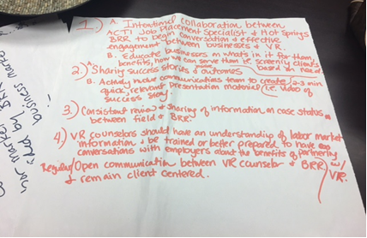
JDVRTAC Collaboration
Interagency Focus Groups

Slide 13
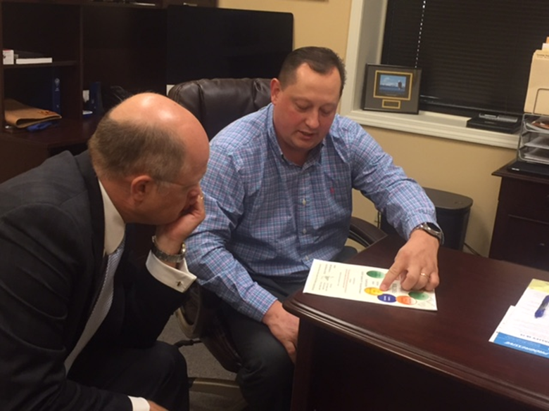
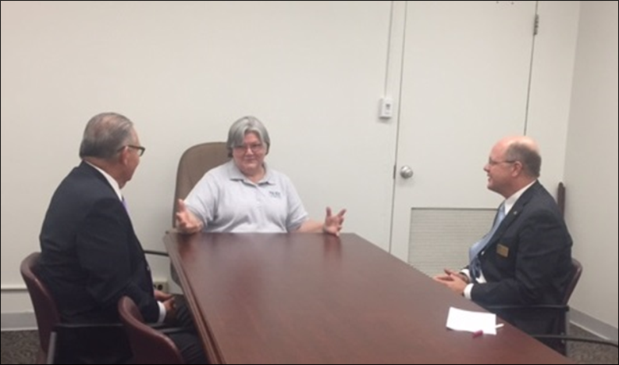
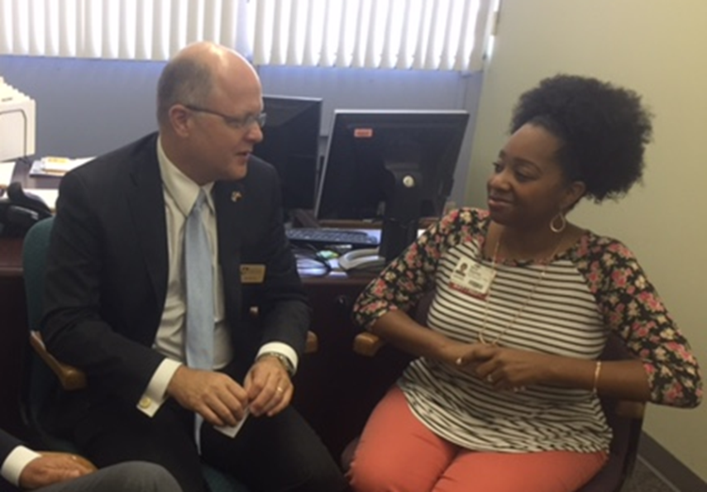
Customer visits
Senior Management and BE
Employer feedback
Trends
Skills needs
Employer support

Slide 14
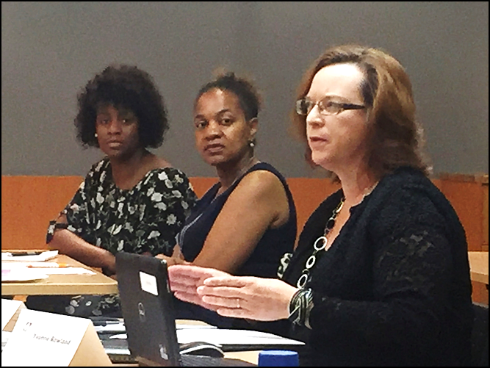
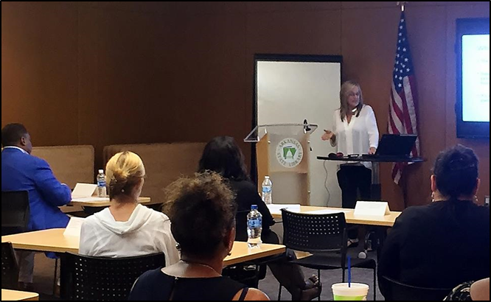
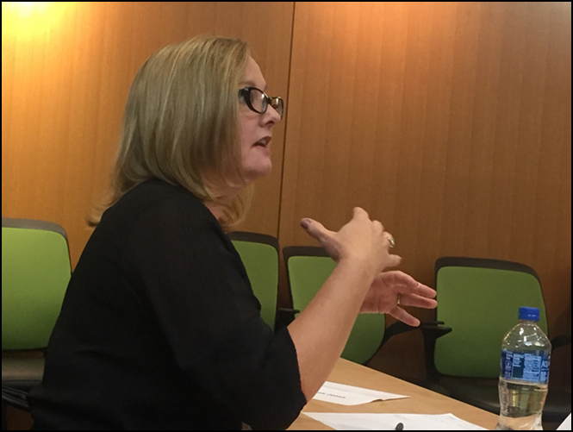
Collaboration and LMI
BE and VR
Career Index Plus
O*Net
Employer Field and Site visits
DWF Labor Market Reports
Chamber of Commerce

Slide 15
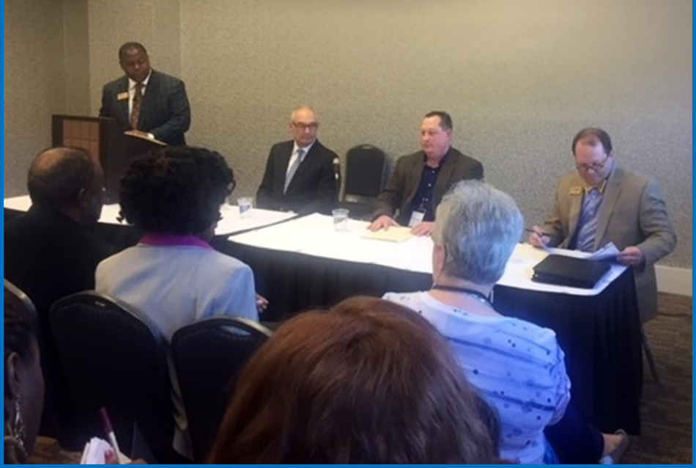
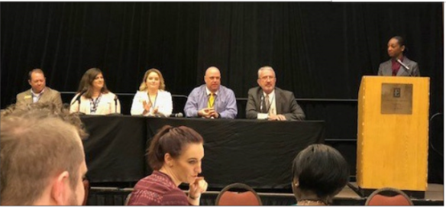
WIOA Business Panels

Slide 16
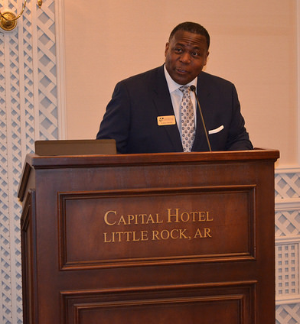
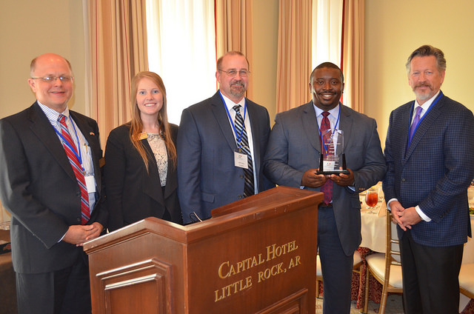
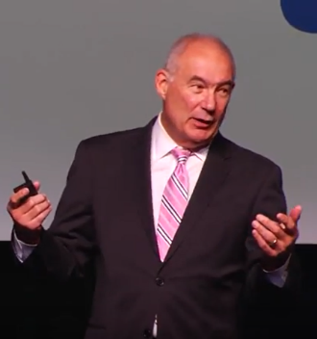
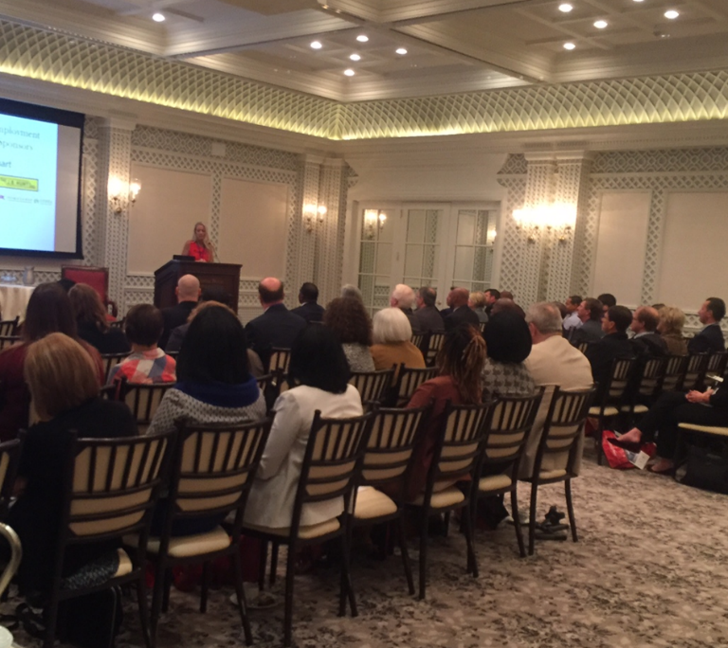
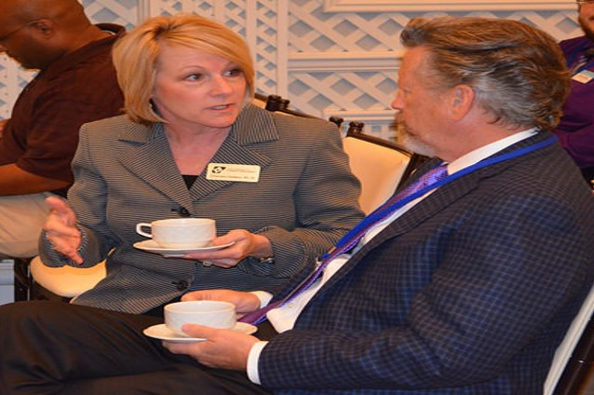
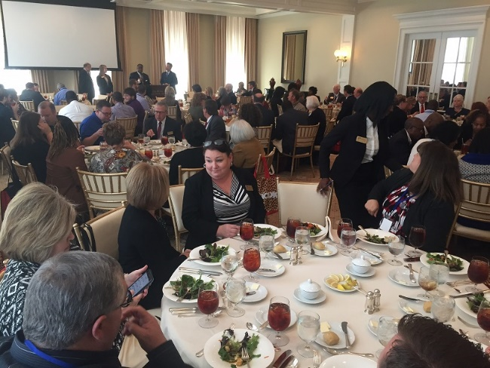
Arkansas Business Employment Summit

Slide 17
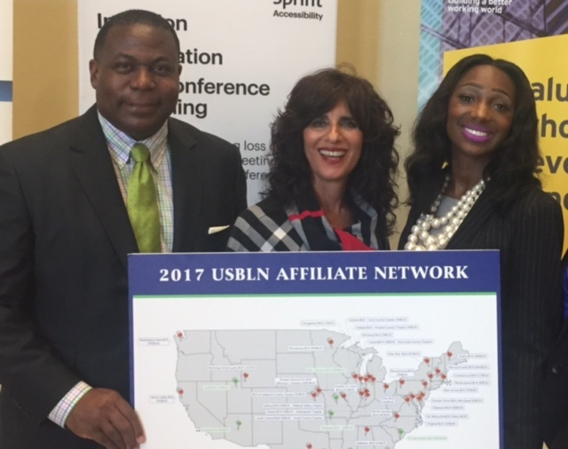
Arkansas Business Leadership Network

Slide 18
JD-VRTAC Project Accomplishments
Engagement across agency
Awareness of critical use of LMI
Increased business involvement
New deliverables
Career index + implementation
Development of customer satisfaction survey

Slide 19
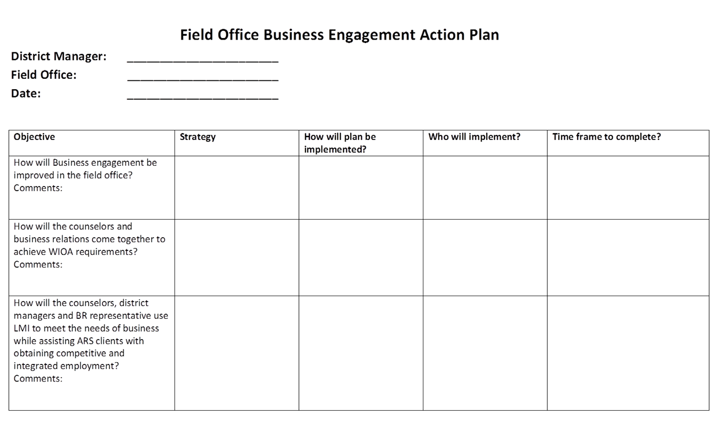
JD-VRTAC Project Accomplishments

Slide 20
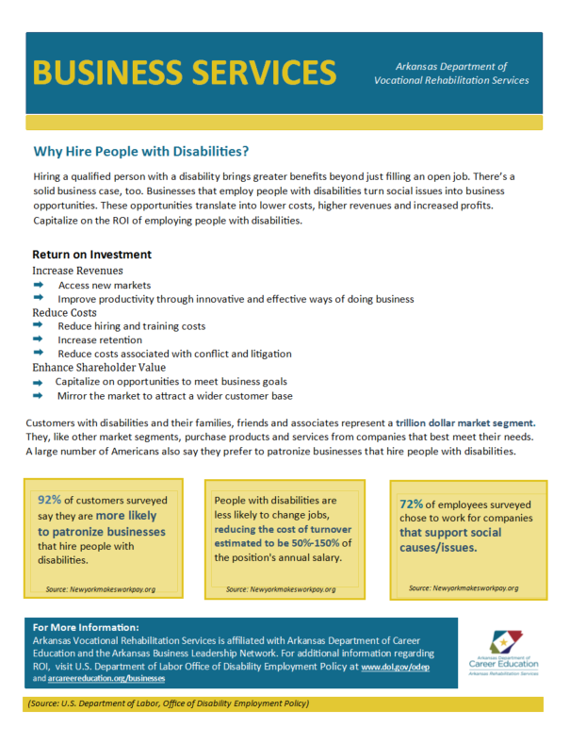
JD-VRTAC Project Accomplishments

Slide 21
JD-VRTAC Project Accomplishments

Slide 22
Project Challenges
Inadequate/Ineffective collaboration among departments
Reduction in staff/resources
Inconsistency across field offices in the area of customer engagement
Restrictions of working within state agency parameters (business services from a social services budget/operation)
Developing marketing plan in keeping with state guidelines/resources
Lack of integrated data system with other partners in workforce
Status quo
Inconsistencies in leadership and administration

Slide 23
Lessons Learned
Change takes time
Cross-communication is necessary
Buy-in with rehabilitation partners is critical
Don’t be afraid to challenge the “status quo”
Creativity and Flexibility are critical

Slide 24
JD-VRTAC Project Today (current status)
Increasing effective communication across agency and with state partners, continued growth of ARBLN
Business Survey near completion
Career index plus being implemented
Developing social media strategy within confines of state agency to promote business engagement

Slide 25
What was most helpful about receiving TA?
Changed agency culture to shift paradigm to business as a customer
Ability to learn and connect with other states
Focus on business engagement and skills needs to better serve our future workforce
Helped promote shift to employer-driven workforce development
Increased Awareness and Use of Labor Market Information
Encouraged framework for cohesion across the agency

Slide 26
Next Steps, Future Directions, and Goals
Launch the ARBLN to operate independently
Social media platform for business engagement
Survey sent out for business customers

Slide 27
Questions?

Slide 28
Contact Information
Arkansas Rehabilitation Services Presenter Contact Information:
Rodney Chandler Rodney.chandler@arkansas.gov 501-296-1665
Ashley Cross Ashley.cross@arkansas.gov 501-686-9608
Yvonne Rowland yvonne.rowland@arkansas.gov 501-683-6962
JD-VRTAC TA Contact Information:
Paula Pottenger: ppottenger@uacurrents.org
Neil McNeil: Neil.McNeil@umb.edu
Kathe Matrone: matrok@uw.edu
Katie Allen: katie.allen@umb.edu

